Slide 1
Empowering and enabling the logistics industry globally.
Structural Design Patterns
Nancy Li
Software Developer
20 Mar 2023

Slide 2
Design Patterns
Structural Design Patterns
Behavioral Design Patterns
Creational Design Patterns
Notes:
Design patterns are typical solutions to commonly occurring problems in software design.
When a solution gets repeated over and over in various projects, someone eventually puts a name to it and describes the solution in detail.
That’s basically how a pattern gets discovered.
You can follow the pattern details and implement a solution that suits the realities of your own program.
Design patterns are divided into three main categories
The first category is Creational patterns, for which I made a presentation last year.
The second is Structural patterns. That's what I want to talk about today.
Structural patterns explain how to assemble objects and classes into larger structures, while keeping these structures flexible and efficient.
//Creational patterns provide object creation mechanisms that increase flexibility and reuse of existing code.
//Behavioral patterns take care of effective communication and the assignment of responsibilities between objects.

Slide 3
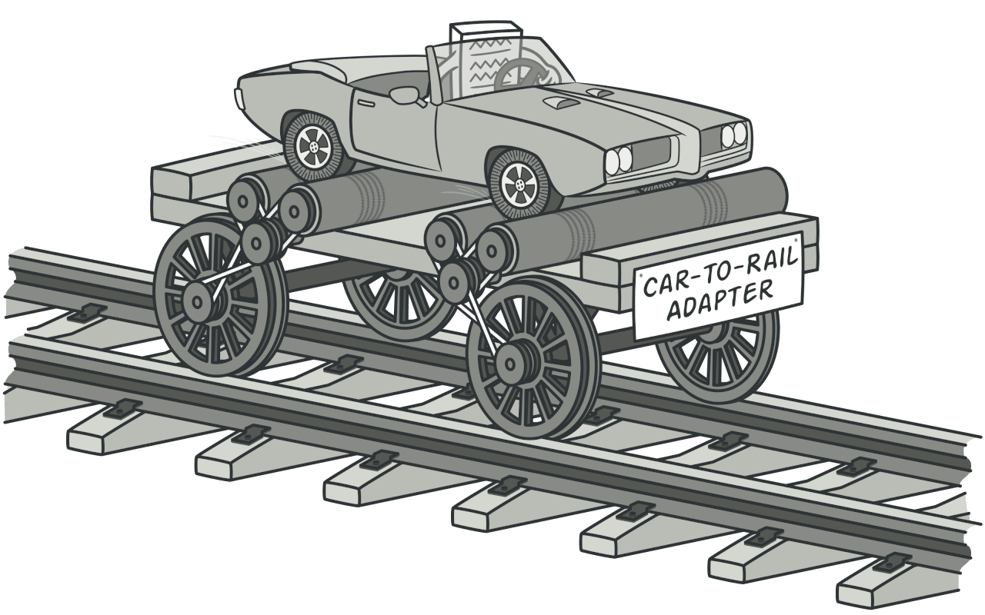
1. Adapter
Notes:
Imagine that there is a rail in front of you, but you only have a car. How can you get to your destination?
As you can see in the picture, we may need a “Car to Rail Adapter”.
The Adapter pattern allows objects with incompatible interfaces to collaborate.
So how can we implement it in actual code? Let's take a look at the example.

Slide 4
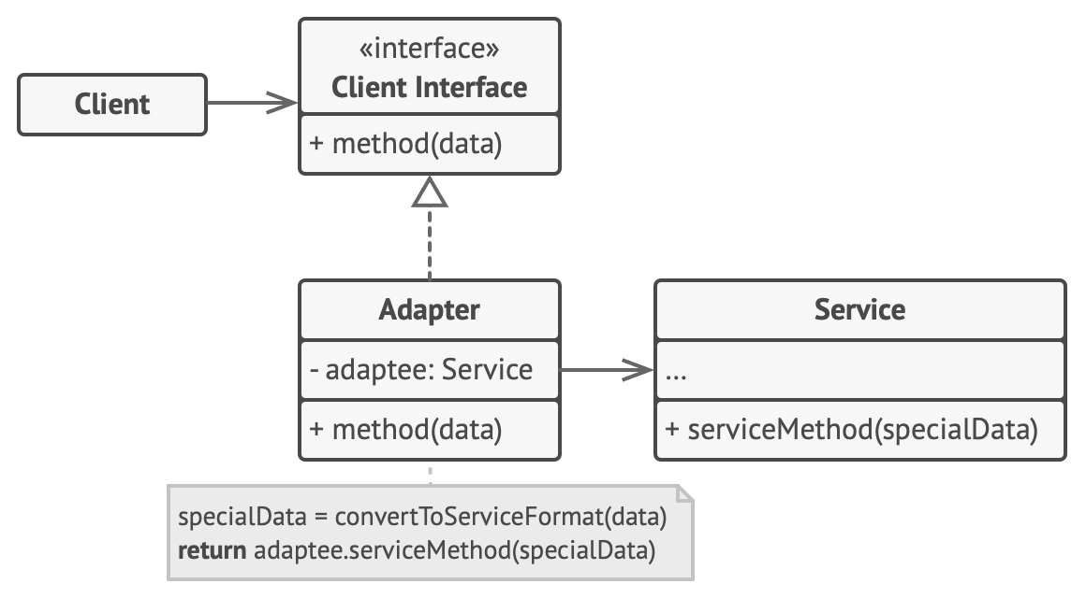
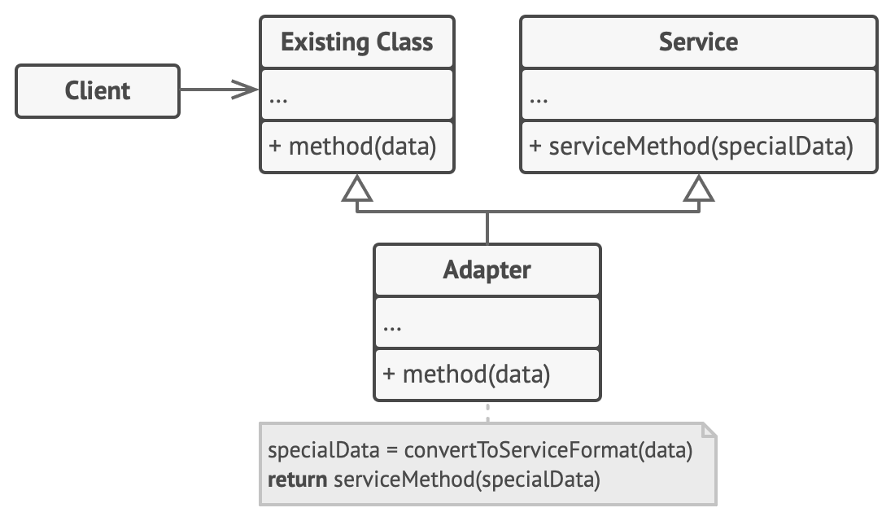
1. Adapter
Target (Client Interface)
Adaptee (Service)
Adapter
Object Adapter
Class Adapter
Notes:
This is the complete implementation of this pattern. There are three different roles.
Target is also called Client Interface.
Depending on the implementation, it can also be divided into Object Adapter and Class Adapter.
We call the adapter in the first picture Object Adapter，that’s because it holds object : Adaptee
We call the adapter in the second picture Class Adapter，that’s because it inherits object : Adaptee
//The Adapter is a class that’s able to work with both the client and the service: it implements the client interface, while wrapping the service object.
//The adapter receives calls from the client via the adapter interface and translates them into calls to the wrapped service object in a format it can understand.
//The Client Interface describes a protocol that other classes must follow to be able to collaborate with the client code.
//The Service is some useful class (usually 3rd-party or legacy). The client can’t use this class directly because it has an incompatible interface.

Slide 5
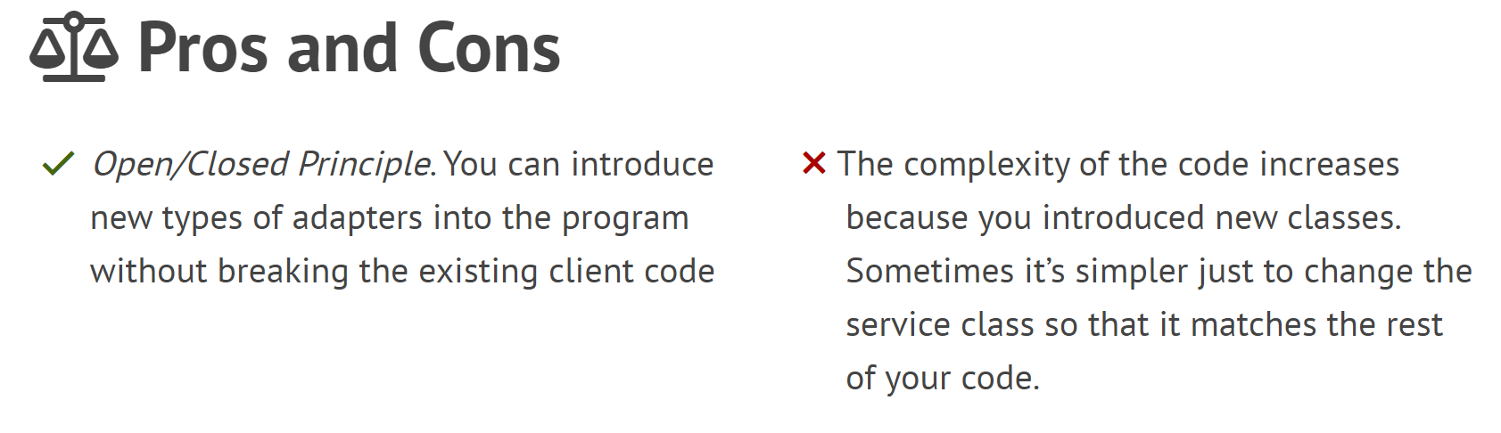
1. Adapter
Notes:
In object-oriented programming, the open/closed principle states "software entities (classes, modules, functions, etc.) should be open for extension, but closed for modification";
In a production environment, any changes are dangerous and may break existing behavior.
//That is, such an entity can allow its behavior to be extended without modifying its source code.
This is especially valuable in a production environment, where changes to source code may necessitate code reviews, unit tests, and other such procedures to qualify it for use in a product: code obeying the principle doesn't change when it is extended, and therefore needs no such effort.

Slide 6
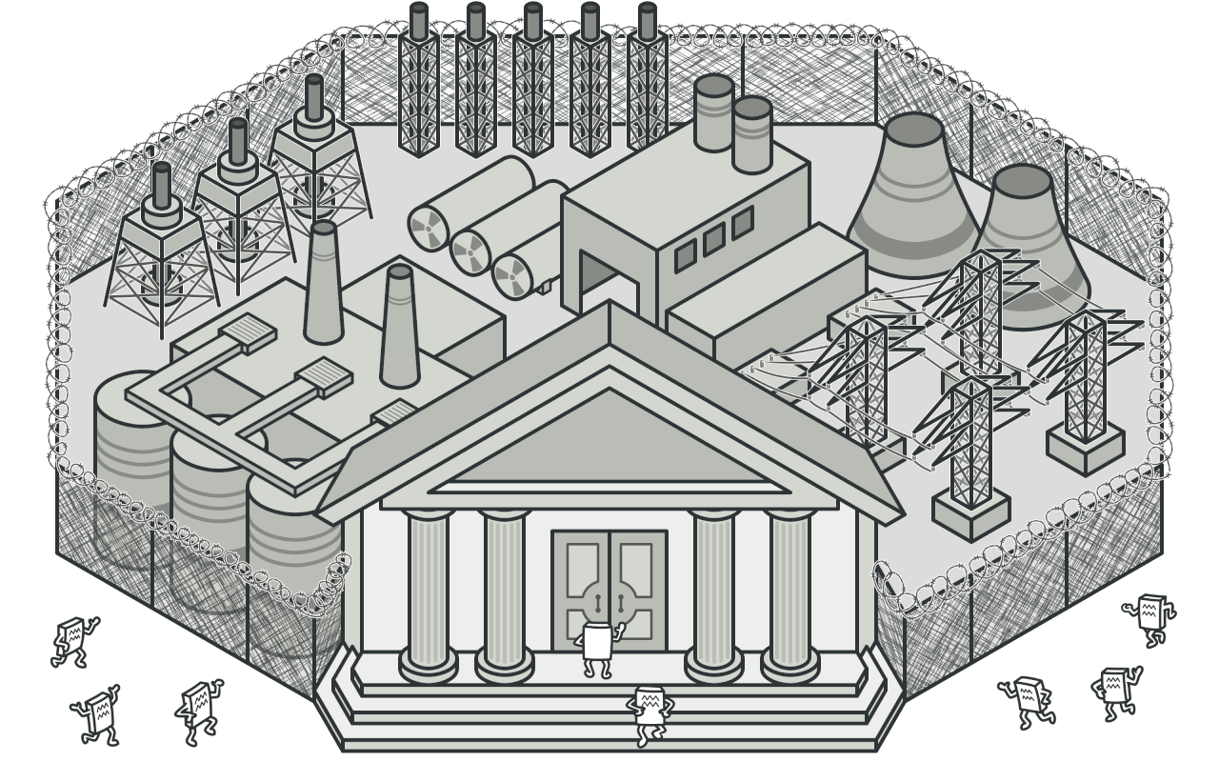
2. Facade
Notes:
Imagine that you must make your code work with a broad set of objects. Those objects belong to a complex library or framework.
Usually, you’d need to initialize all these objects, keep track of dependencies, execute methods in the correct order, and so on.
As a result, the business logic of your classes would become tightly coupled to the implementation details of these objects, making it hard to maintain.
Facade provides a simplified interface to a library, a framework, or any other complex set of classes.

Slide 7
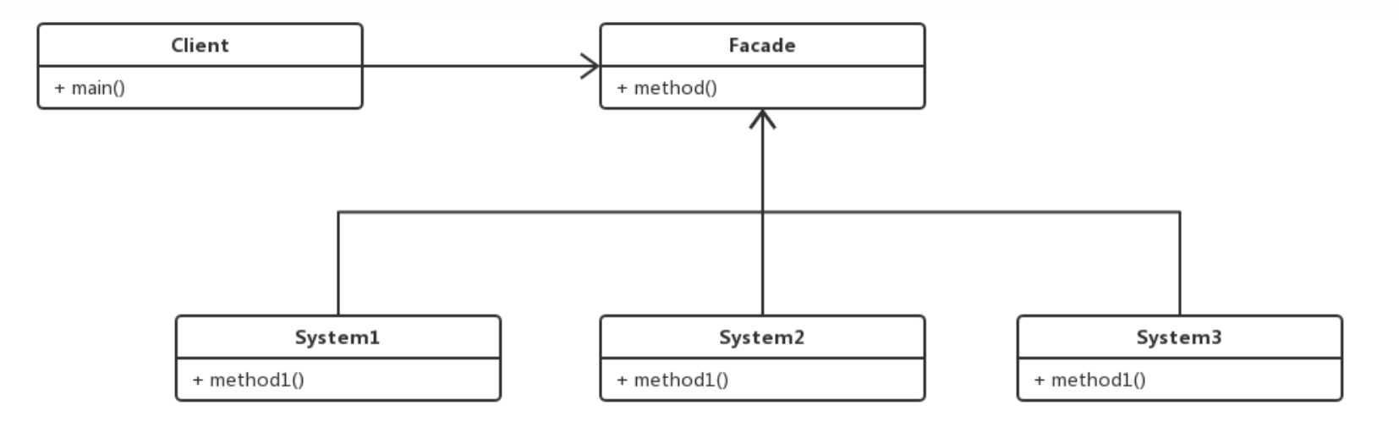
2. Facade
Sub System
Facade
Notes:
The Facade provides convenient access to a particular part of the subsystem’s functionality. It knows where to direct the client’s request and how to operate all the moving parts.
The Complex Subsystem consists of dozens of various objects.
To make them all do something meaningful, you must dive deep into the subsystem’s implementation details, such as initializing objects in the correct order and supplying them with data in the proper format.
Subsystem classes aren’t aware of the facade’s existence. They operate within the system and work with each other directly.

Slide 8
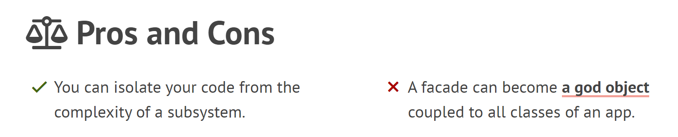
2. Facade
Notes:
The client code won’t get into complex logic of one or several subsystems.
In the actual project, Subsystems often get more complex over time. The configuration it requires grows ever larger.
The Facade attempts to fix this problem by providing a shortcut to the most-used features of the subsystem //which fit most client requirements.
However, the Facade delegates the requests to subsystem.

Slide 9
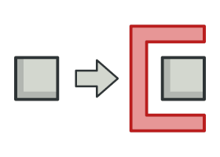
3. Proxy
Notes:
Proxy lets you provide a substitute(替代品) or placeholder for another object.
The box on the left refers to Client code
The box on the right, you can think of it as the original object we want to use.
The Proxy is the red part in this picture.
It controls access to the original object, allowing you to perform something either before or after the request gets through to the original object.

Slide 10
3. Proxy
Protection Proxy - Access control
Remote Proxy - Local execution of a remote service
Logging Proxy - Logging requests
Caching Proxy - Caching request results
……
Notes:
There are four commonly used scenarios for the proxy pattern:
Protection Proxy, it can pass the request to the service object under certain conditions.
Remote Proxy, it can pass the request over the network, handling all of the details of working with the network.
Logging Proxy, it can log each request before passing it to the service.
Caching Proxy, it can implement caching for recurring requests that always return the same results. The proxy may use the parameters of requests as the cache keys.

Slide 11
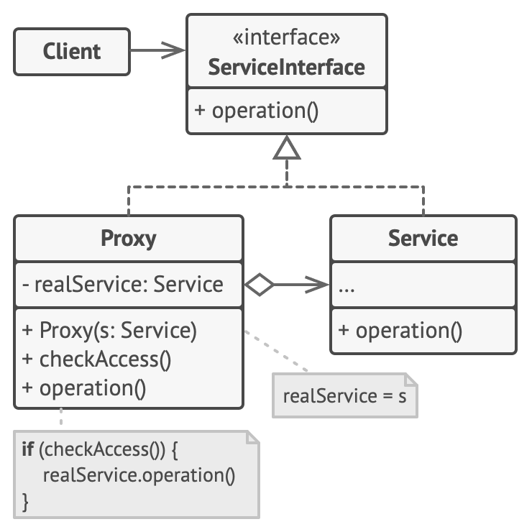
3. Proxy
Subject (Service Interface)
Real Subject (Service)
Proxy
Notes:
The Service Interface declares the interface of the Service. //The proxy must follow this interface to be able to disguise itself as a service object.
The Service is a class that provides some useful business logic.
The Proxy class has a reference field that points to a service object.
After the proxy finishes its processing (e.g., lazy initialization, logging, access control, caching, etc.), it passes the request to the service object.
Usually, proxy manage the full lifecycle of the service object.

Slide 12
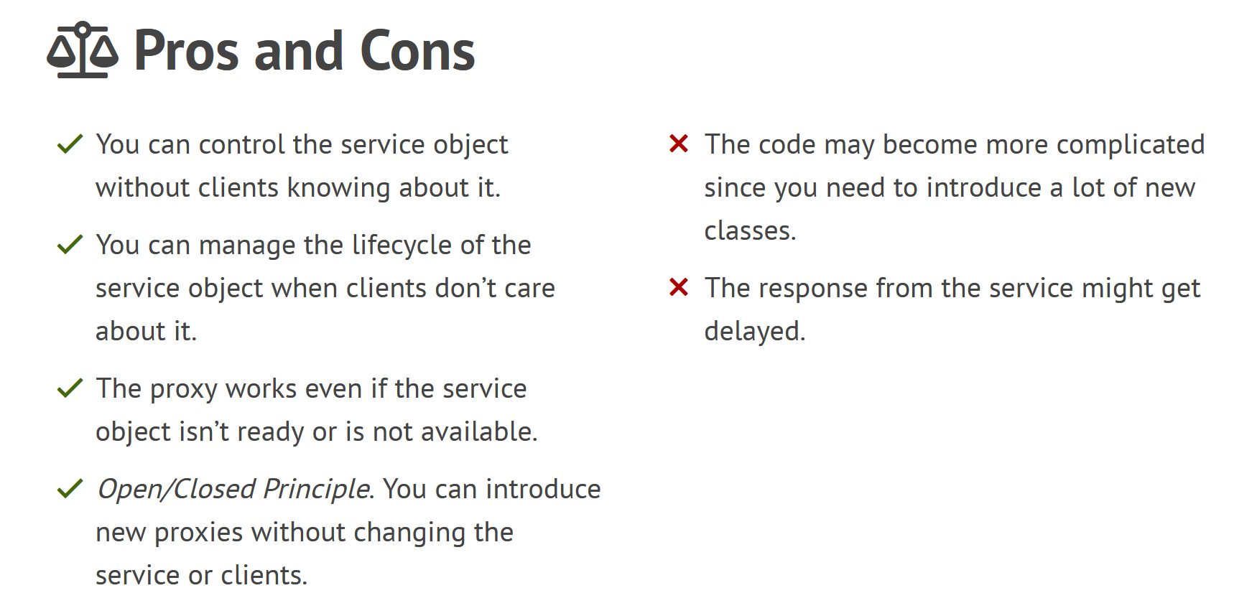
3. Proxy
Notes:
Since you may have other operation after receiving result.

Slide 13



4. Bridge
Notes:
Imagine you now have some building blocks of different shapes, and then you get some paints.
You want to change these building blocks to different colors. Then you can build a colorful house with these blocks.
So how can you build these RedCircle, RedSquare, BlueCircle, BlueSquare in code?

Slide 14
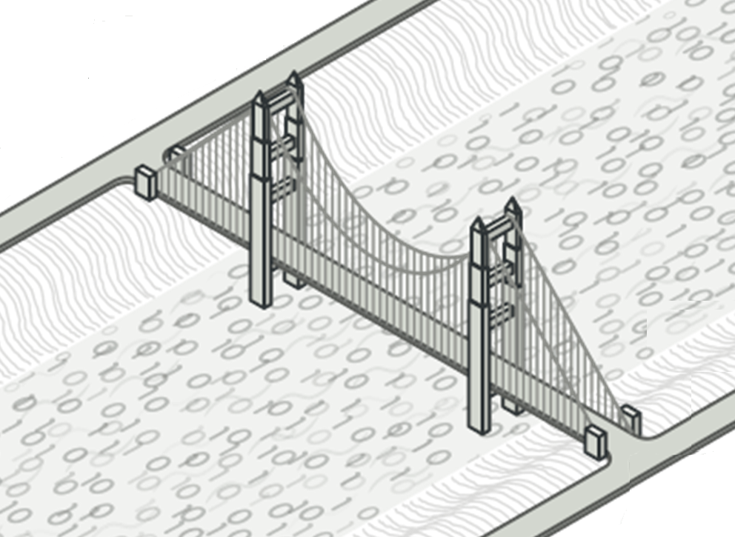
4. Bridge
Notes:
It is required to correctly identify two independently changing parts in the system.
In our example,
In fact, there are two main types of objects we need.
The first type is shape,
And the second type is color,
Through bridge, we can link different shapes and colors, to get the colored shape we want.
Bridge Pattern lets you split a large amount of closely related classes into two separate layers //—abstraction and implementation—
which can be developed independently of each other.
//Different implementations are interchangeable as long as they follow a common interface.

Slide 15
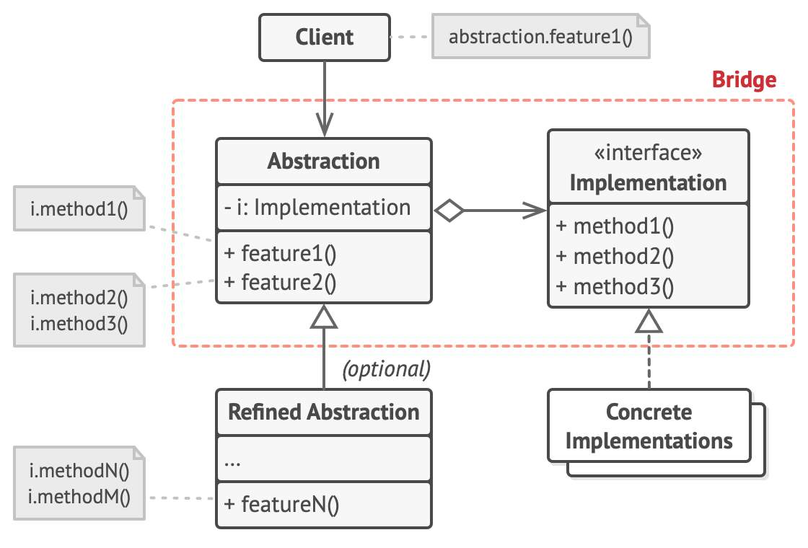
4. Bridge
Abstraction
Refined Abstraction
Implementation
Concrete Implementations
Color
Red
Blue
White
Shape
Circle
Rectangle
Square
Notes:
The Abstraction class has a reference field that points to Implementation.
The Abstraction provides high-level control logic. It relies on the implementation object to do the actual low-level work.
The Implementation declares the interface that’s common for all concrete implementations.
An abstraction can only communicate with an implementation object via methods that are declared here.
The abstraction may list the same methods as the implementation, but usually the abstraction declares some complex behaviors that rely on a wide variety of primitive operations declared by the implementation.
Concrete Implementations contain platform-specific code.
Refined Abstractions provide variants of control logic. Like their parent, they work with different implementations via the general implementation interface.
Usually, the Client is only interested in working with the abstraction. However, it’s the client’s job to link the abstraction object with one of the implementation objects.

Slide 16
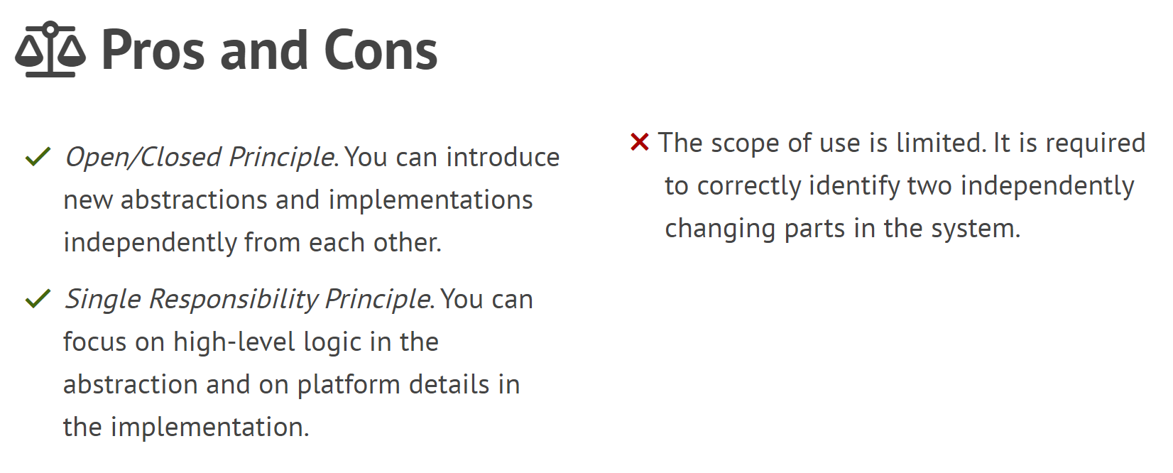
4. Bridge
Notes:
The scope of use is limited.
The bridge mode requires the correct identification of two independently changing dimensions in the system, so its scope of use has certain limitations
The Single Responsibility Principle: a class should have only one reason to change.

Slide 17
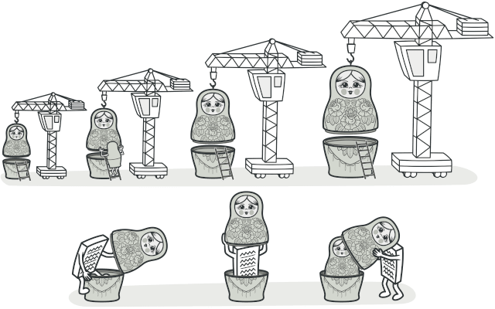
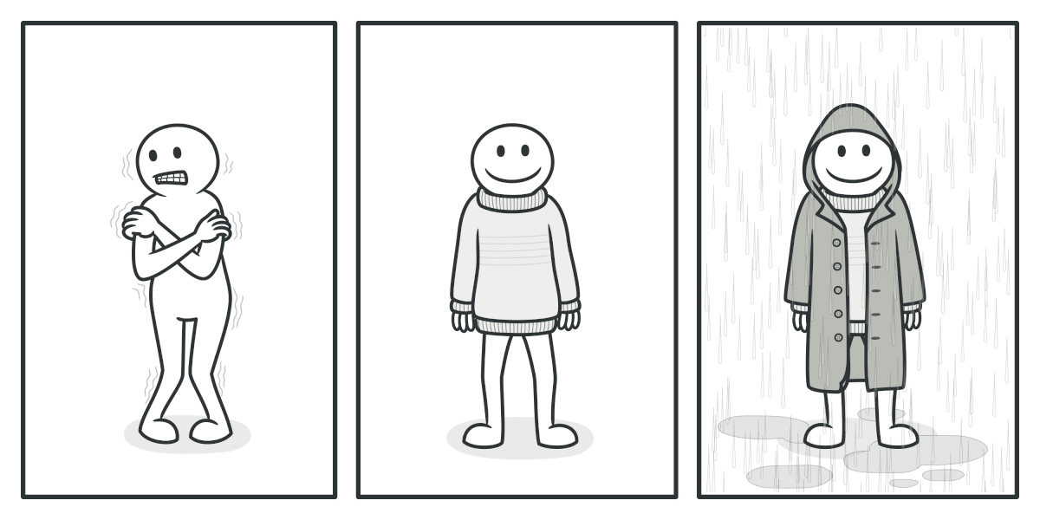
5. Decorator
Notes:
Decorator lets you attach new behaviors to objects by placing these objects inside special wrapper objects.
The nesting(套入) has earned this approach the nickname "Russian dolls.“
Wearing clothes is another example of using decorators.
When you’re cold, you wrap yourself in a sweater.
If you’re still cold with a sweater, you can wear a jacket on top.
If it’s raining, you can put on a raincoat.
All these clothes “extend” your basic behavior but aren’t part of you, and you can easily take off any piece of clothing whenever you don’t need it.

Slide 18
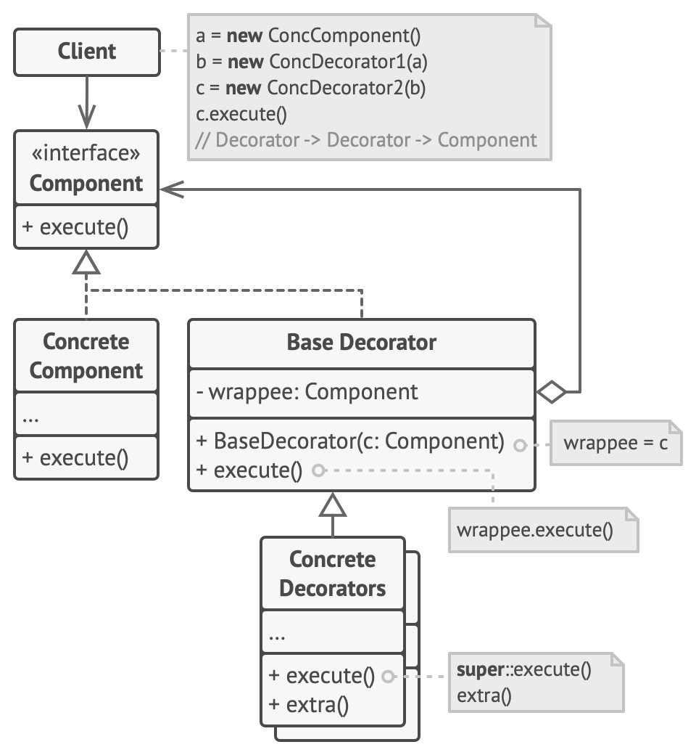
5. Decorator
Component
Concrete Component
Base Decorator
Concrete Decorator
Notes:
The Component declares defines operations that can be altered by decorators.
It’s the common interface for both wrappers and wrapped objects.
Concrete Component is a class of objects being wrapped. It defines default implementations of the operations.
The Base Decorator class has a field for referencing a wrapped object.
The Base Decorator delegates all operations to the wrapped object.
The field’s type should be declared as the component interface so it can contain both concrete components and decorators.
Concrete Decorators define extra behaviors that can be added to components dynamically.
Concrete Decorators override methods of the base decorator and execute their behavior either before or after calling the parent method.

Slide 19
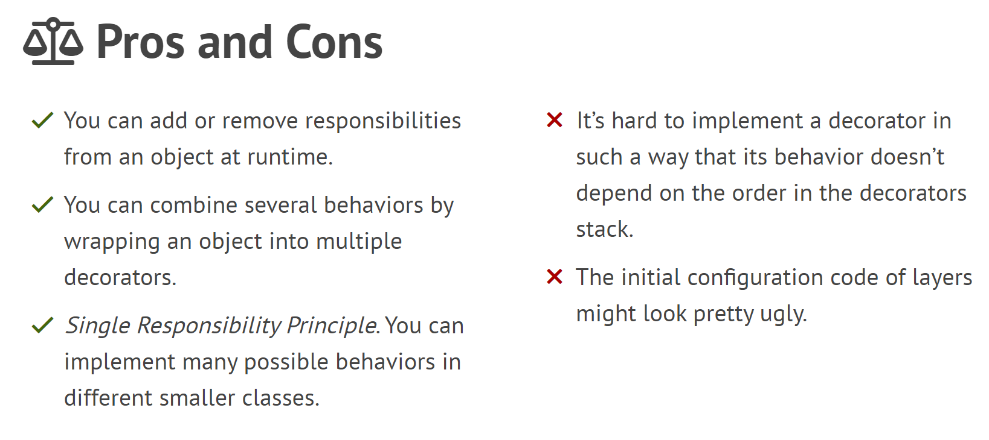
5. Decorator

Slide 20
Structural Design Patterns
1. Adapter
2. Facade
3. Proxy
4. Bridge
…….
5. Decorator
Notes:
These are the five Structural Design Patterns.
I hope it can be helpful to everyone.
Adapter allows objects with incompatible interfaces to collaborate.
Facade provides a simplified interface to a library, a framework, or any other complex set of classes.
Proxy lets you provide a substitute or placeholder for another object.
Bridge lets you split a large amount of closely related classes into two separate layers, which can be developed independently of each other.
Decorator lets you attach new behaviors to objects by placing these objects inside special wrapper objects.

Slide 21
Q&A

Slide 22
Empowering and enabling the logistics industry globally.
Thank You!

